Slide 1
Introduction to NLP
5. Probabilistic Parsing
Dr. John McCrae
Data Science Institute, NUI Galway

Slide 2
Phrase and Dependency Grammars

Slide 3

Models of language - independence
with people valley childishly madison . destroyed elite or leadership
the be , example back to also of would only
in unassisted men random rule years from is would last
Words are chosen at random

Slide 4
Models of language - n-gram
the book is to dishearten either side of the meaning
in that can sympathetically the three others , followed by
we all his local callers in one entry that everyone
Words are chosen only based on previous few words
Notes:
https://colab.research.google.com/drive/1TdGYqPXgWxSUfod2XZ9DfA3K0GklIlV9#scrollTo=5KywCAPvD0qQ

Slide 5
Long-distance dependencies
The girl, who is playing with cars, likes toast

Slide 6
Parsing as rewriting
The girl, who is playing with cars, likes toast
POS Tagging
DT NN WP VBZ VBG IN NNP VBZ NN
NP
NP
S
VP
VP

Slide 7
Phrase grammars
Terminals: words in the language
Pre-terminals: part-of-speech values
https://www.ling.upenn.edu/courses/Fall_2003/ling001/penn_treebank_pos.html
Non-terminals:
Categories such as ‘VP’ (verb phrase), ‘NP’ (noun phrase)
Start symbol: Usually ‘S’

Slide 8
Phrase grammars
A list of rules of the form
X → A B C …
Where A, B, C can be terminals, pre-terminals or non-terminals (not the start symbol!)

Slide 9
Issues with phrase grammar
Order: Important for languages such as English, but not so much for other languages
Consider 3rd person singular agreement:
S → NP-3ps VP-3ps
S → NP-not-3ps VP-not-3ps
NP-3ps → DT NN
VP-3ps → VBZ
NP-not-3ps → DT NNS
VP-not-3ps → VBP
Dependency modelling can require many rules

Slide 10
Dependency parsing
The girl, who is playing with cars, likes toast
aux
det
nsubj
prep
pobj
dobj
relcl
nsubj

Slide 11
Dependency parsing as constituency parsing
ROOT
attr
nsubj
det
nsubj
attr
this
is
an
example
AUX
det
DET
NOUN
DET
Dependency rules can be mapped to constituency rules, e.g.,
ROOT → nsubj AUX attr
this
is
an
example

Slide 12
Parsing examples

Slide 13
Probabilistic Context-Free Grammars

Slide 14
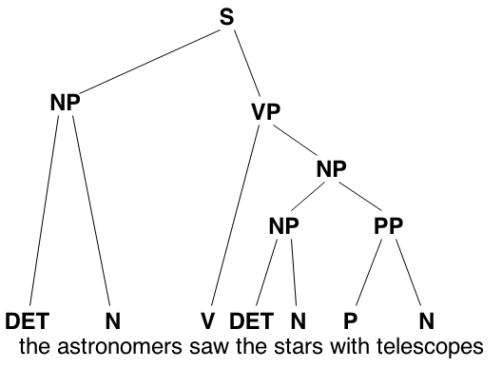
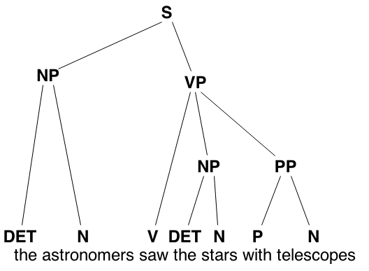
Ambiguity
Parses are often ambiguous

Slide 15
Probabilistic CFGs
To parse a sentence assume we start with a symbol S
We use a rule S → NP VP to rewrite this to NP VP
We continue to rewrite until we reach the words of the sentence we wish to parse
What are the events?
Where should we assign probability?
How do we calculate the probability of the sentence?

Slide 16
Probabilistic CFG
Which probabilities below should sum to one?
Rule | Prob
S → NP VP | 1.0
NP → NN | 0.3
NP → DT NN | 0.4
NP → DT JJ NN | 0.3
VP → V NP | 0.3
VP → V | 0.4
VP → V NP PP | 0.3
Terminal rules | 1.0
S
NP VP
NN VP
This V NP
This is NP
This is DT NN
This is an example
P = 1.0
P = 1.0
P = 0.3
P = 0.09
P = 0.09
P= 0.036
What is the probability of the parse?

Slide 17
Context-free grammars
Recall, a context-free grammar G=(N,Σ,P,S) consists of:
A set of non-terminal symbols N
e.g., 'N', 'VP', 'S'
A set of terminal symbols Σ
e.g., 'cat', 'astronomer', 'the'
A set of productions P
e.g., 'S → NP VP'
A start symbol
Normally 'S'

Slide 18
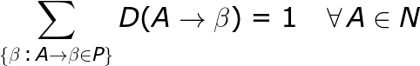
Probabilistic context-free grammar
A probabilistic context-free grammar G=(N,Σ,P,S,D) consists of:
N, Σ, P, S as for a CFG
A function D:P→[0,1] which assigns a probability to each production
A PCFG is consistent iff
And there are no infinite derivations for any finite string (e.g., S→S)
Notation
Lowercase letters: Terminal (word), e.g. a,the
Capital letters: Non-terminal, e.g., N, V
Greek letters: Sequence of terminal and non-terminals
𝛜 : Empty sequence
Notes:
\sum_{\{\beta \,:\, n \rightarrow \beta \in P \}} D(n \rightarrow \beta) = 1 ~~~ \forall \,n \in N

Slide 19
Example: PCFG
Rule | Prob | Rule | Prob
S → NP VP | 0.80 | VP → V NP | 0.90
S → Aux NP VP | 0.20 | VP → V NP NP | 0.10
NP → PN | 0.45 | N → flights | 1.00
NP → Nom | 0.05 | V → book | 1.00
NP → Pro | 0.50 | Aux → can | 1.00
Nom → N | 0.95 | PN → Lufthansa | 1.00
Nom → PN Nom | 0.05 | Pro → you | 1.00

Slide 20
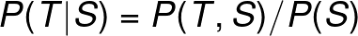
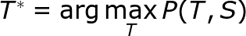
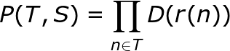
Calculating the probability of a parse
We wish to know how likely a parse T is, given input S
Ergo, the best parse is
And as the parse tree contains all words in the sentence
Hence
Where r(n) is the rule used to generate n
Notes:
P(T|S)=P(T,S)P(S)
T^*=\arg\max_T P(T,S)
P(T,S)=P(T)P(S|T)=P(T)
P(T,S)=\prod_{n\in T}D(r(n))

Slide 21
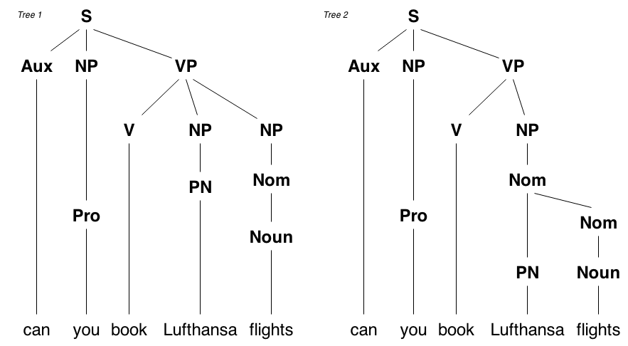
Example: Parsing with PCFG

Slide 22
Example: Parsing with PCFG
Tree 1
P(Tree 1) = 0.2 × 0.5 × 0.1 × 0.05 × 0.45 × 0.95 × 1.0 × 1.0 × 1.0 × 1.0 × 1.0
= 0.00021
Exercise: Tree 2
S → Aux NP VP | 0.20 | Aux → can | 1.00
NP → Pro | 0.50 | Pro → you | 1.00
VP → V NP NP | 0.10 | V → book | 1.00
NP → Nom | 0.05 | PN → Lufthansa | 1.00
NP → PN | 0.45 | N → flights | 1.00
Nom → N | 0.95

Slide 23
CYK Algorithm

Slide 24
Chomsky Normal Form
Add a new restriction on rules:
Exactly 2 non-terminals
or one terminal
X → A B C
X → A Y
Y → B C
What about if there is one non-terminal or a mix of terminals and non-terminals?

Slide 25
PCFG in CNF
Rule | Prob | Rule | Prob
S → NP VP | 0.80 | VP → V NP | 0.90
S → Aux S’ | 0.20 | VP → V VP’ | 0.10
S’ → NP VP | 1.00 | VP’→ NP NP | 1.00
NP → PN | 0.45 | Nom → flights | 0.95
NP → Nom | 0.05 | V → book | 1.00
NP → Pro | 0.50 | Aux → can | 1.00
Nom → N | 0.95 | NP → Lufthansa | 0.45
NP → PN Nom | 0.0025 | NP → you | 0.50
Nom → PN Nom | 0.05 | NP → flights | 0.0475
 |  | PN → Lufthansa | 1.0

Slide 26
Finding the best parse
It is not practical to find all parse trees (exponential number)
We can also find the best parse in O(N³)
Two most commonly used algorithms are easily adaptable to PCFG
Earley algorithm
Cocke-Younger-Kasami (CYK) algorithm

Slide 27
Cocke-Younger-Kasami Algorithm
can | you | book | Lufthansa | flights
Aux: 1.0 | NP: 0.5 | V: 1.0 | NP: 0.45 PN: 1.0 | Nom: 0.95 NP: 0.04 | 1
 |  |  |  |  | 2
 |  |  |  |  | 3
 |  |  |  |  | 4
 |  |  |  |  | 5
Rule | Prob | Rule | Prob
S → NP VP | 0.80 | VP → V NP | 0.90
S → Aux S’ | 0.20 | VP → V VP’ | 0.10
S’ → NP VP | 1.00 | VP’→ NP NP | 1.00
NP → Lufthansa | 0.45 | PN → Lufthansa | 1.0
NP → you | 0.50 | V → book | 1.00
NP → flights | 0.04 | Aux → can | 1.00
NP → PN Nom | 0.01 | Nom → flights | 0.95
 |  | Nom → PN Nom | 0.05
Multiple options so we have multiple values

Slide 28
Cocke-Younger-Kasami Algorithm
can | you | book | Lufthansa | flights
Aux: 1.0 | NP: 0.5 | V: 1.0 | NP: 0.45 PN: 1.0 | Nom: 0.95 NP: 0.04 | 1
 |  |  | VP: 0.9 × 0.45 × 1.0 | NP: 0.0095 VP’: 0.018 Nom: 0.048 | 2
 |  |  |  |  | 3
 |  |  |  |  | 4
 |  |  |  |  | 5
Rule | Prob | Rule | Prob
S → NP VP | 0.80 | VP → V NP | 0.90
S → Aux S’ | 0.20 | VP → V VP’ | 0.10
S’ → NP VP | 1.00 | VP’→ NP NP | 1.00
NP → Lufthansa | 0.45 | PN → Lufthansa | 1.0
NP → you | 0.50 | V → book | 1.00
NP → flights | 0.04 | Aux → can | 1.00
NP → PN Nom | 0.01 | Nom → flights | 0.95
 |  | Nom → PN Nom | 0.05
No rule for Aux NP
Check both V NP and V PN

Slide 29
Cocke-Younger-Kasami Algorithm
can | you | book | Lufthansa | flights
Aux: 1.0 | NP: 0.5 | V: 1.0 | NP: 0.45 PN: 1.0 | Nom: 0.95 NP: 0.04 | 1
 |  |  | VP: 0.4 | NP: 0.0095 VP’: 0.018 Nom: 0.048 | 2
 |  |  | S: 0.162 S’: 0.2 | VP: 0.0086 | 3
 |  |  |  |  | 4
 |  |  |  |  | 5
Rule | Prob | Rule | Prob
S → NP VP | 0.80 | VP → V NP | 0.90
S → Aux S’ | 0.20 | VP → V VP’ | 0.10
S’ → NP VP | 1.00 | VP’→ NP NP | 1.00
NP → Lufthansa | 0.45 | PN → Lufthansa | 1.0
NP → you | 0.50 | V → book | 1.00
NP → flights | 0.04 | Aux → can | 1.00
NP → PN Nom | 0.01 | Nom → flights | 0.95
 |  | Nom → PN Nom | 0.05
Here we check:
V NP and V VP’ and VP Nom and VP NP
We generate VP twice
P(VP → V NP,...) = 0.90 × 1.0 × 0.0095
P(VP → V VP’,...) = 0.10 × 1.0 × 0.045

Slide 30
Cocke-Younger-Kasami Algorithm
can | you | book | Lufthansa | flights
Aux: 1.0 | NP: 0.5 | V: 1.0 | NP: 0.45 PN: 1.0 | Nom: 0.95 NP: 0.04 | 1
 |  |  | VP: 0.4 | NP: 0.0095 VP’: 0.018 Nom: 0.048 | 2
 |  |  | S: 0.162 S’: 0.2 | VP: 0.0086 | 3
 |  |  | S: 0.041 | S: 0.0034 S’: 0.00428 | 4
 |  |  |  | S: 0.00086 | 5
Rule | Prob | Rule | Prob
S → NP VP | 0.80 | VP → V NP | 0.90
S → Aux S’ | 0.20 | VP → V VP’ | 0.10
S’ → NP VP | 1.00 | VP’→ NP NP | 1.00
NP → Lufthansa | 0.45 | PN → Lufthansa | 1.0
NP → you | 0.50 | V → book | 1.00
NP → flights | 0.04 | Aux → can | 1.00
NP → PN Nom | 0.01 | Nom → flights | 0.95
 |  | Nom → PN Nom | 0.05
We generate S here but is does not cover the whole input

Slide 31
Probabilistic Cocke-Younger-Kasami Algorithm
CYK is essentially a bottom-up parser
Can be adapted to PCFGs with dynamic programming
Input:
A PCFG
n words w₁,…,w_{n}
Data structure:
A table t_{i,j,a} ∈ R where 1≤i<j≤n and a∈N
Output:
The best parse T=argmax_{T}P(T)

Slide 32
CYK Algorithm
Set t_{i,j,a} = 0 for all values
For i = 1, …., n
For A → w_{i} ∈ P
t_{i,i+1,A} = D(A → w_{i})
For k = 1, … , n ; i = 1, … , n - k + 1 ; j = i + k
For A → β ∈ P
If β matches between i and j
S = D(A → β) × ∏_{i’,j’,A’} t_{i’,j’,A’} where {i’,j’,A} are the matches
If s > t_{i,j,A}
t_{i,j,A} = s
Return t_{1,n,S} (S is the start symbol)

Slide 33
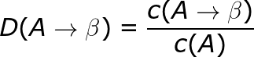
Supervised learning of PCFGs
If we have a gold-standard corpus of known trees we can learn from this
Corpus of trees is called a treebank
PCFG probabilities can be obtained by counting
Smoothing can be applied.
Notes:
D(A\rightarrow \beta) = \frac{c(A\rightarrow \beta)}{c(A)}

Slide 34
Challenges for parsing

Slide 35
Lexical Dependencies
In a CFG the expansion of one non-terminal is independent of any other non-terminal
In Francis et. al (1999)
Subjects are
91% pronouns
9% lexical noun phrases
Direct objects are
34% pronouns
66% lexical noun phrases
Ergo, we would need to distinguish between NP in subject and direct object positions
Francis, H. S., Gregory, M. L., and Michaelis, L. A. (1999). Are lexical subjects deviant?. In CLS-99

Slide 36
Lexical Attachment
Lexical attachment is very word dependent
For example:
he hit the man with a bat
he hit the man with a hat
PCFGs cannot model lexical dependencies

Slide 37
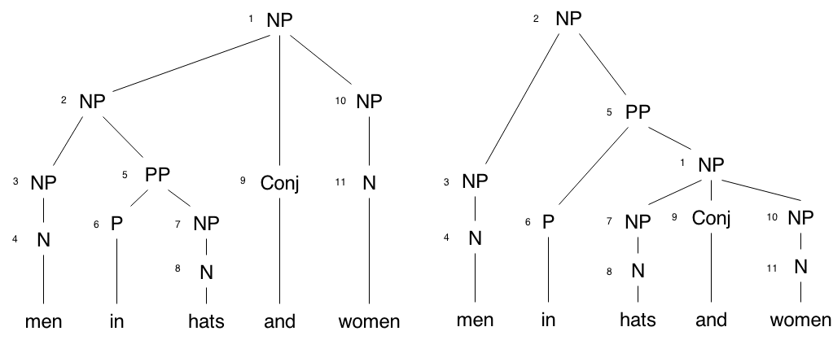
Parse ambiguity

Slide 38
Formalisms for statistical parsing
We will look at two solutions for parsing:
Lexicalized PCFGs
Further differentiate non-terminals by associating them with lexical items
Leads to increased sparsity
Dependency grammars
Model links between individual words in the parse
Complex to combine with standard CFG

Slide 39
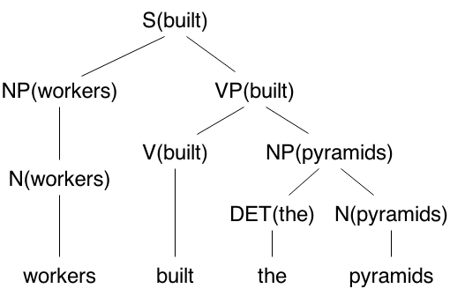
Lexicalized PCFGs
In a lexicalized grammar each non-terminal is further distinguished with a terminal
Heuristic rules decide which non-terminal is the head of the parent

Slide 40
Lexicalized PCFGs
Lexicalizing the grammar creates many more rules
Extremely sparse
It is common to make some partial independence assumption, e.g.,
In addition, most parses still apply significant smoothing methods (see lecture 3)
Notes:
P(VP(\text{built}) \rightarrow V(\text{built})~NP(\text{pyramids}))) \simeq P(VP(\text{built}) \rightarrow V(\cdot)~NP(\cdot)) P(VP(\text{built}) | NP(\text{pyramids}))

Slide 41
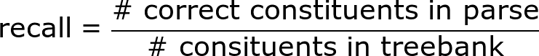
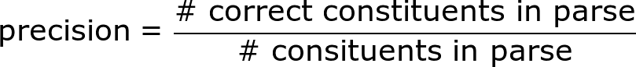
Evaluation of Parsing
Parsers are generally evaluated according to the PARSEVAL metrics
In addition we report cross-brackets
This is where the parser outputs ((A B) C) but the candidate is (A (B C))
Modern parsers achieve 90%+ precision and recall and 1% cross-bracketing
Notes:
\text{recall} = \frac{\text{\# correct constituents in parse}}{\text{\# consituents in treebank}}
\text{precision} = \frac{\text{\# correct constituents in parse}}{\text{\# consituents in parse}}

Slide 42
Summary
Parsing allows us to capture long-distance dependencies
Two frameworks are widely used:
Constituency and dependency parsing
The best parse tree can be found in cubic time
PCFGs have problems
Cannot capture non-direct dependencies
Cannot capture sibling dependencies
Sometimes, cannot distinguish unlike trees
Lexicalized PCFGs fix these issues by adding a head word to each non-terminal

Slide 43
Lab of this Week
Exercises on probabilistic parsing using NLTK

Slide 44
QA

